Slide 1
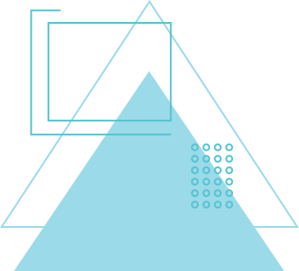
PATHFINDER
REAL-TIME COMPUTER VISION-BASED NAVIGATION SYSTEM
Team HVBR
IIITH

Slide 2
WHO WE ARE
We are a team of 4 CSD students working under professor Nagamani and TA Ansh.
Team members:
Vijay Aravynthan (2023111007)
Bhaskar Itikela (2023111032)
Harshil Singh (2023111003)
Monosij Roy (2023111016)

Slide 3
GOAL
We plan to make a functional prototype that can assist visually impaired individuals in navigating mapped environments.
Combines object detection, ultrasonic, and audio feedback for better accuracy.
Designed for environments configured with visual markers or in general obstacle-dense areas.
The device uses YOLOv11 segmentation AI, a camera and an ultrasonic sensor.

Slide 4
PROBLEM STATEMENT
GENERAL OVERVIEW
Navigating complex environments without visual cues is challenging for the visually impaired.
Current solutions
lack real-time feedback
versatile obstacle detection algorithms
Expensive
Need custom hardware
Need for a cheap, portable, accessible, and efficient navigation aid.

Slide 5
SOFTWARE USED
YOLOv11 Segmentation
Real-time scene processing using YOLOv11 for obstacle detection. (Uses PyTorch)
OpenCV
For processing the image data
Tkinter
For the initial GUI
PIL (only for preview)
For previewing the input source
pyttsx3
Text to speech on the fly

Slide 6
HARDWARE USED
Camera
Main video input for object detection.
HC-SR04 Ultrasonic Sensor
Measures obstacle distances.
ESP32 Microcontroller
Interfaces the sensor and the PC through Serial (Can be remote as well
RGB Color markers
Directional guidance via color-based markers
PC
Proccessing the visual and distance measurements on device
Audio cues for navigation feedback.

Slide 7
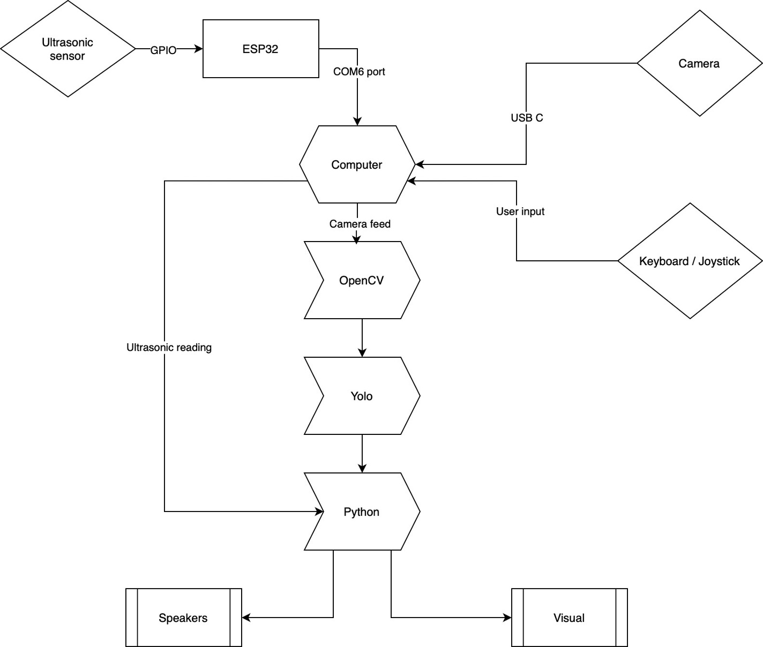
BLOCK DIAGRAM

Slide 8
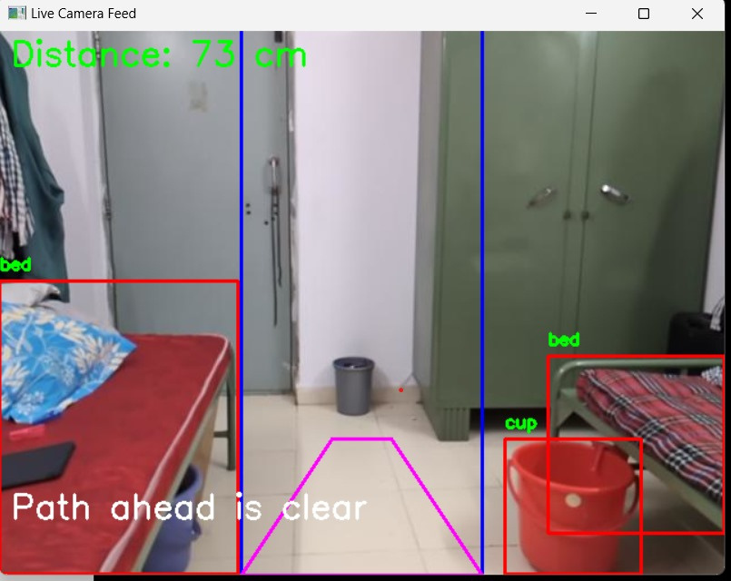
WORKING PRINCIPLE
Picture depicting Clear path ahead
Title: Obstacle and Path Detection
YOLOv11 detects obstacles in the left, center, and right camera regions.
Ultrasonic sensors confirm clearance or proximity to obstacles.
Visual cues (red/blue markers) guide navigation decisions

Slide 9
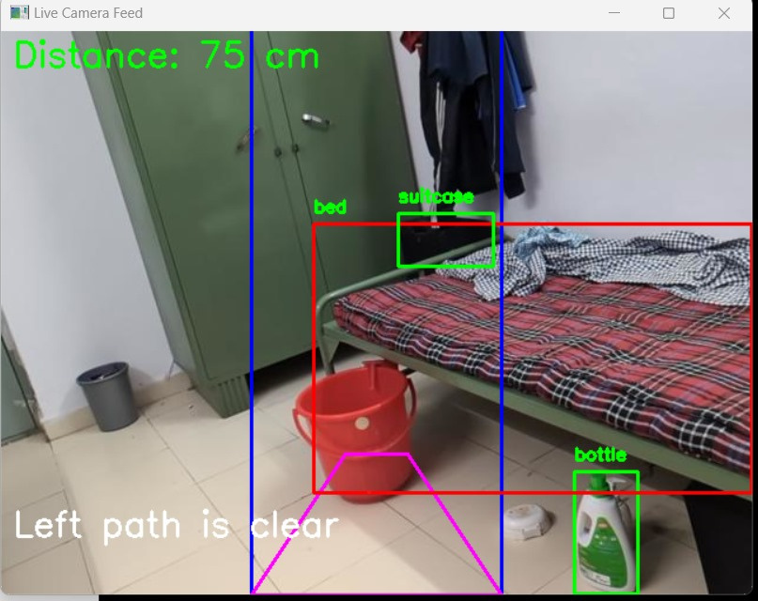
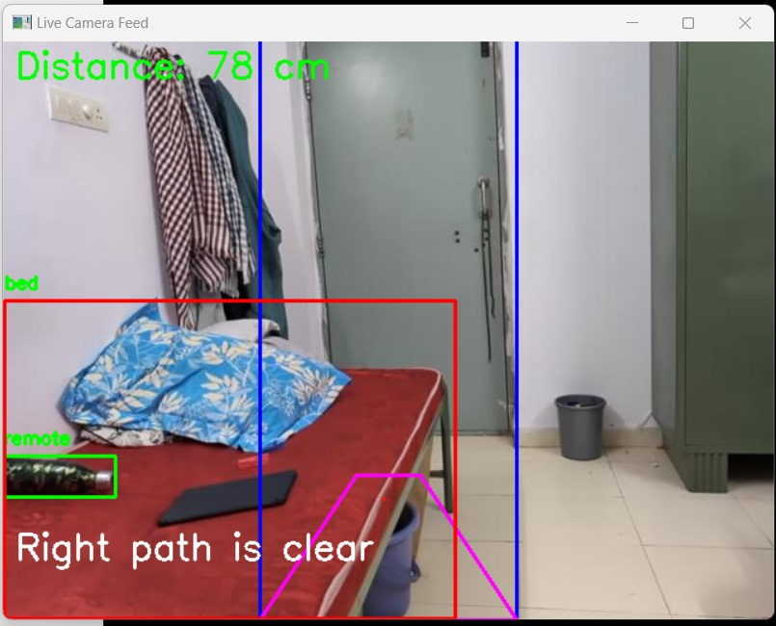
WORKING PRINCIPLE
The picture below below depicts a clear left path
The picture below below depicts a clear right path.

Slide 10
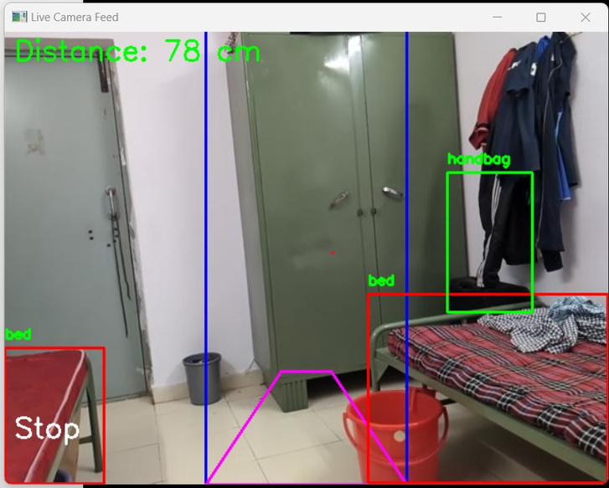
WORKING PRINCIPLE
If there all the sides are covered , its says to stop
The picture below below depicts a clear right path.

Slide 11
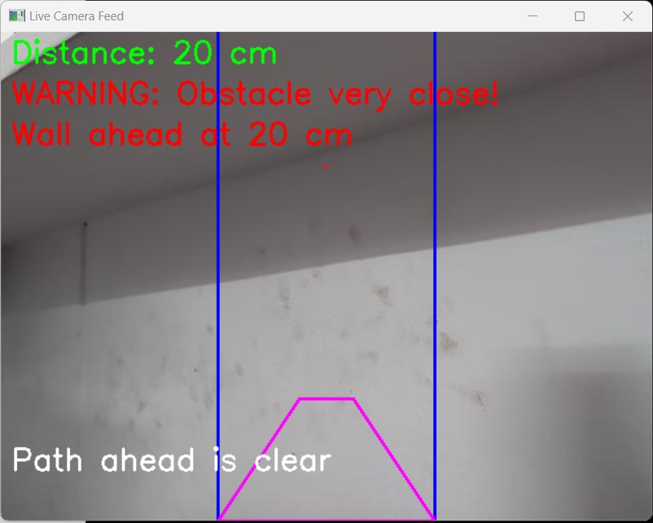
WORKING PRINCIPLE
The picture below depicts that no object or person are detected , and the wall is 20cm ahead.
WALL DETECTION
If YOLOv11 doesn’t detect any obstacle, (for e.g. if there is a wall), then the ultrasonic sensor readings are taken into account to detect if the person can move forward or not.

Slide 12
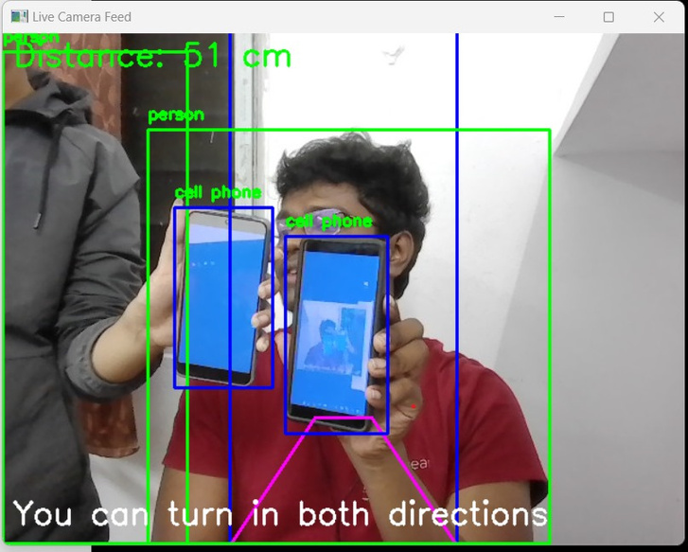
WORKING PRINCIPLE
YOLOv11 can also detect color-based visual cues to inform the person of the direction they can/should go.
Visual cues (red/blue markers) guide navigation decisions:
Blue+Blue → Go any direction
Red+Red → Stop (Dead End)
Red+Blue → Turn right
Blue+Red → Turn Left

Slide 13
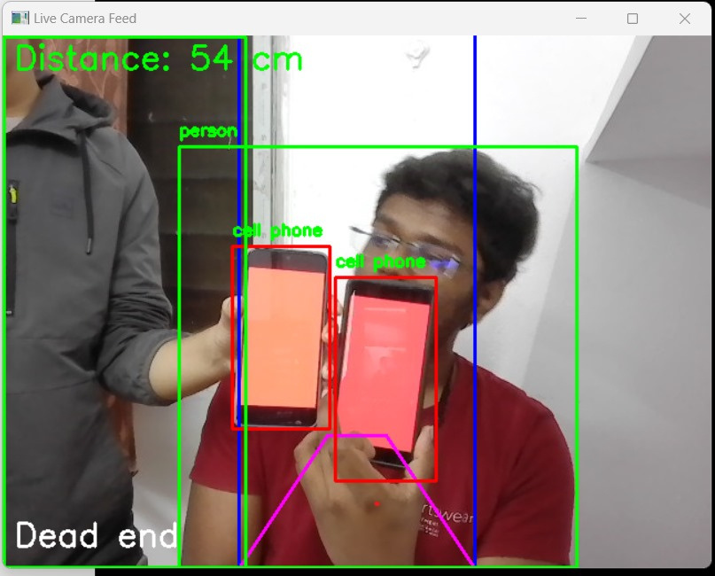
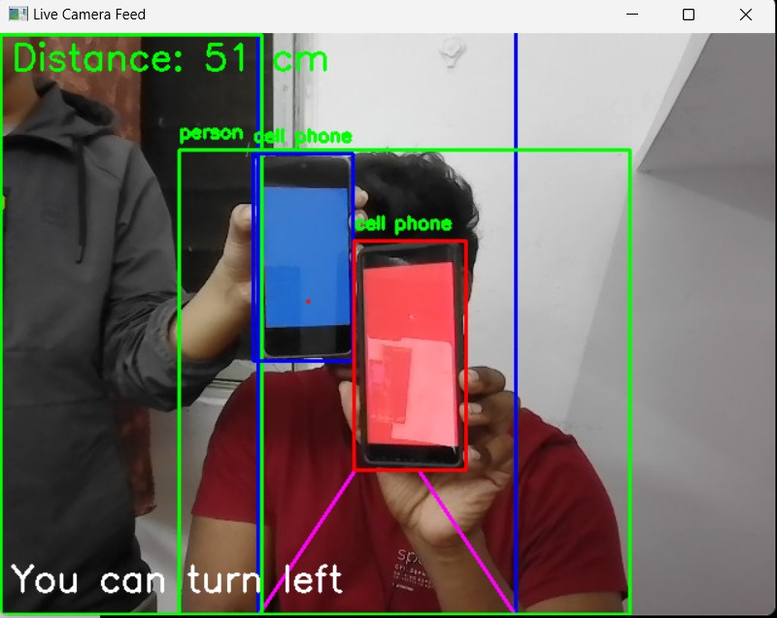
WORKING PRINCIPLE
Red cues on both sides: The person should not turn left or right.
dead end.

Slide 14
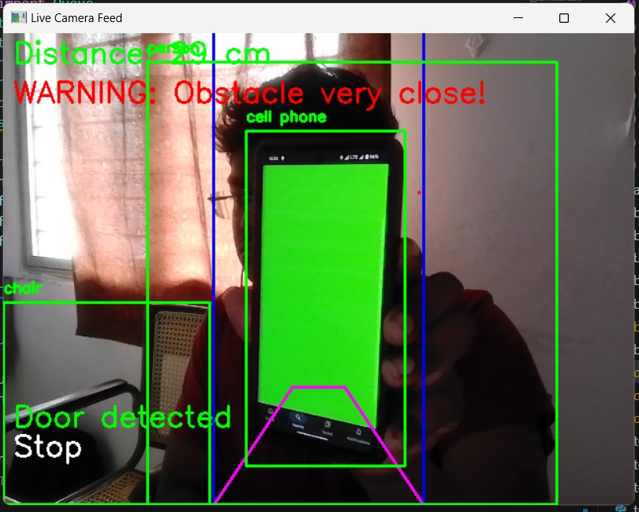
WORKING PRINCIPLE
Green in center + distance < threshold:
Door detected

Slide 15
INTERACTION
Input from the A give the informations about obstacles nearby and clear paths.
Input from the D gives the description of the environment like the object and their position.
Visual indicators on GUI for additional assistance.

Slide 16
USE CASES
Environments with proper visual cues
Buildings with required cues at intersections and dead ends to support accurate guidance.
Additionally, if the map of the building is known beforehand, then the program can be modified to guide the user to any destination within the building.
Environments without any cues
In such environments, the program still works properly as an obstacle/wall detector.

Slide 17
CHALLENGES AND ASSUMPTIONS
Challenges
High power consumption due to real-time processing.
Performance is sensitive to lighting conditions
Assumptions
Pre-configured markers enhance navigation reliability.

Slide 18
FUTURE APPLICATIONS
The prototype can be turned into an APK and deployed on QIDK and even Android phones with sufficient processing power.
The program can be modified to detect doors and convey this information to the user.
Instead of an ultrasonic sensor, Lidars present in the phone can be used for depth perception.
Integration with smart glasses or wearable devices.
Instead of 2 colored markers, we can make it detect the direction with a arrow.

Slide 19
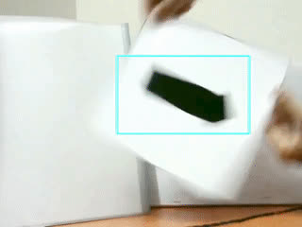

Slide 20
EVALUATION
Object Detection Accuracy: 80-85% depending on model used
Average Processing Time: 50 ms/frame
Distance Measurement Accuracy: ±5 cm

Slide 21
CONCLUSION
Provides a safe, efficient navigation aid for visually impaired individuals.
Combines cutting-edge AI with user-friendly feedback systems.
Significant potential for scaling and future improvements.

Slide 22
CONTRIBUTIONS
Bhaskar Itikela
YOLOv11 Integration
Navigation Logic
Main script
Testing
Vijay Aravynthan
YOLOv11 Integration
Navigation Logic
Report and PPT
Testing
Harshil Singh
Integrate ultrasonic sensor
Report and PPT
Look into Android deployment
Testing
Monosij Roy
Integrate ultrasonic sensor
Report and PPT
Look into Android deployment
Testing

Slide 23
THANK YOU
TEAM HVBR

